Slide 1
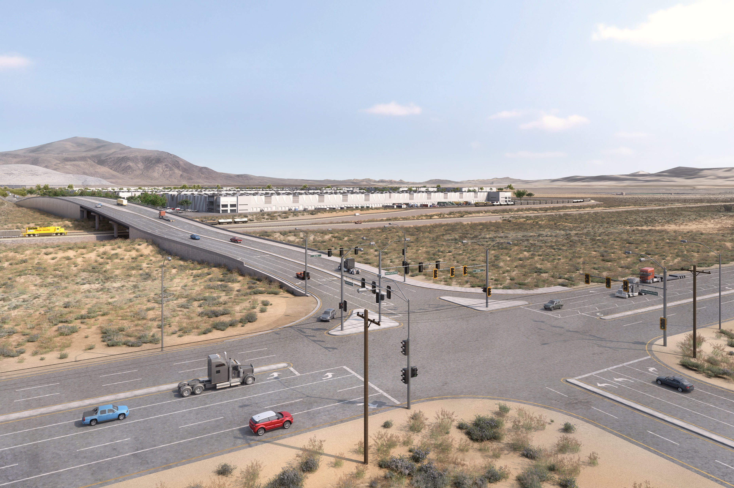



Nevada Pacific Parkway Extension RAISE Grant Project
Mark IV Capital in partnership with City of Fernley
May 13th, 2024

Slide 2
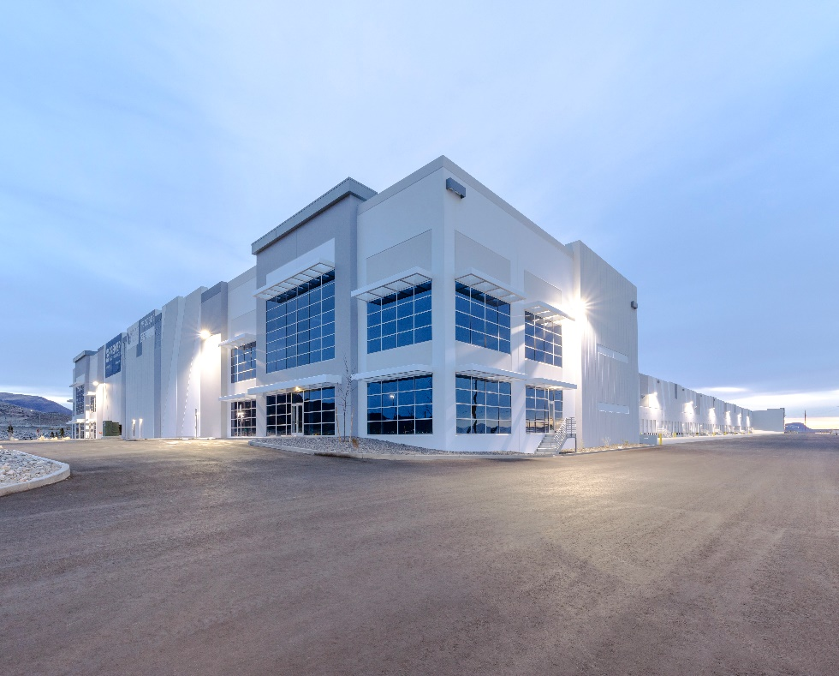
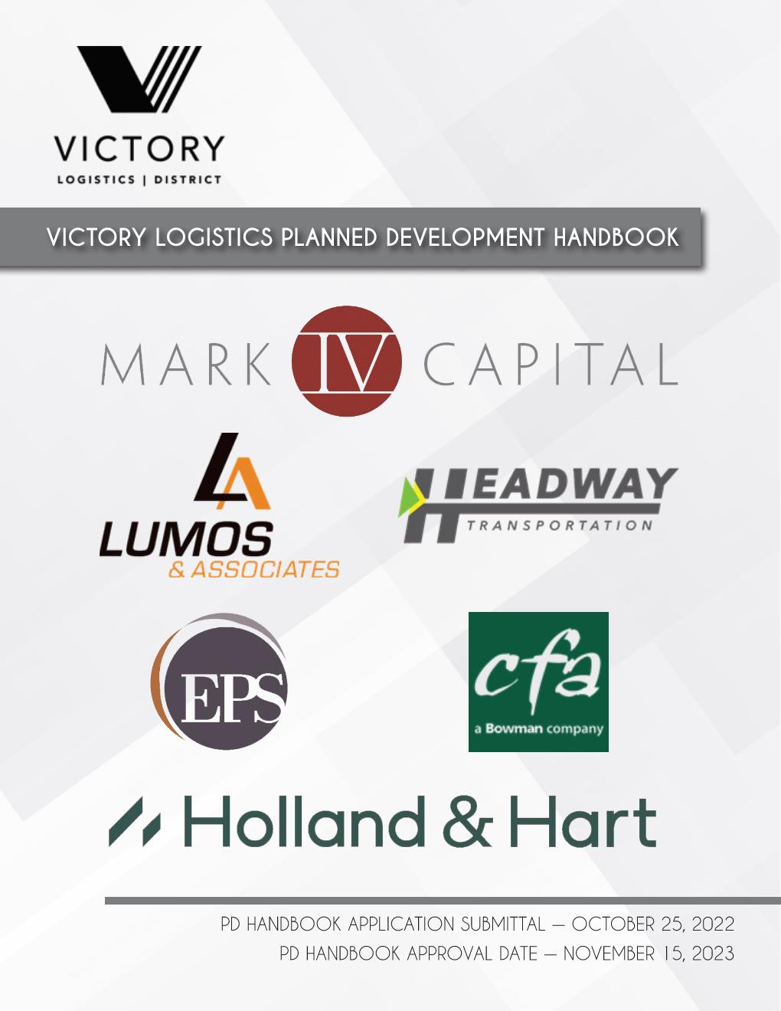
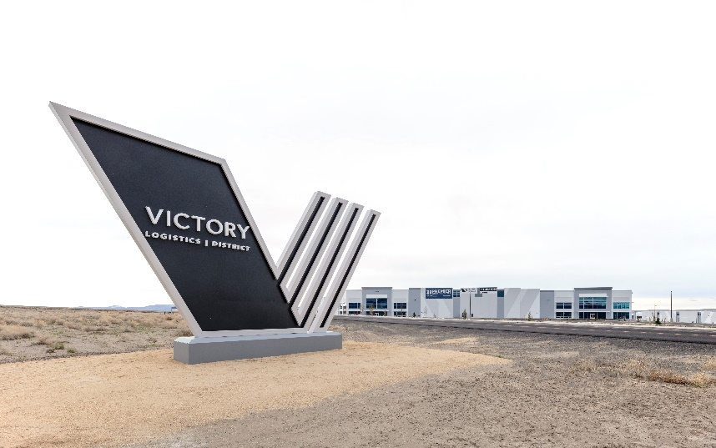

The Why Behind Nevada Pacific Parkway
2019
2020
2022
2024
2021
2023
Mark IV purchased 4,300 acres of land previously known as Sonterra
Victory Logistics Project goals established
30% Design complete for Nevada Pacific Parkway
Grant applications started for NPP jointly with the City of Fernley
Master Planning complete for 2,164 acres of Victory Logistics MPA 1
Building A Completed: 815,000 SF Dock High Spec Building
$25 M RAISE Grant awarded for NPP
NEPA commences on Nevada Pacific Parkway
Buildings B, C, and D2 completed: additional 1,020,000 SF of dock high spec buildings
Tentative Map, Planned Development Handbook, and Development Agreement complete for Victory MPA1

Slide 3
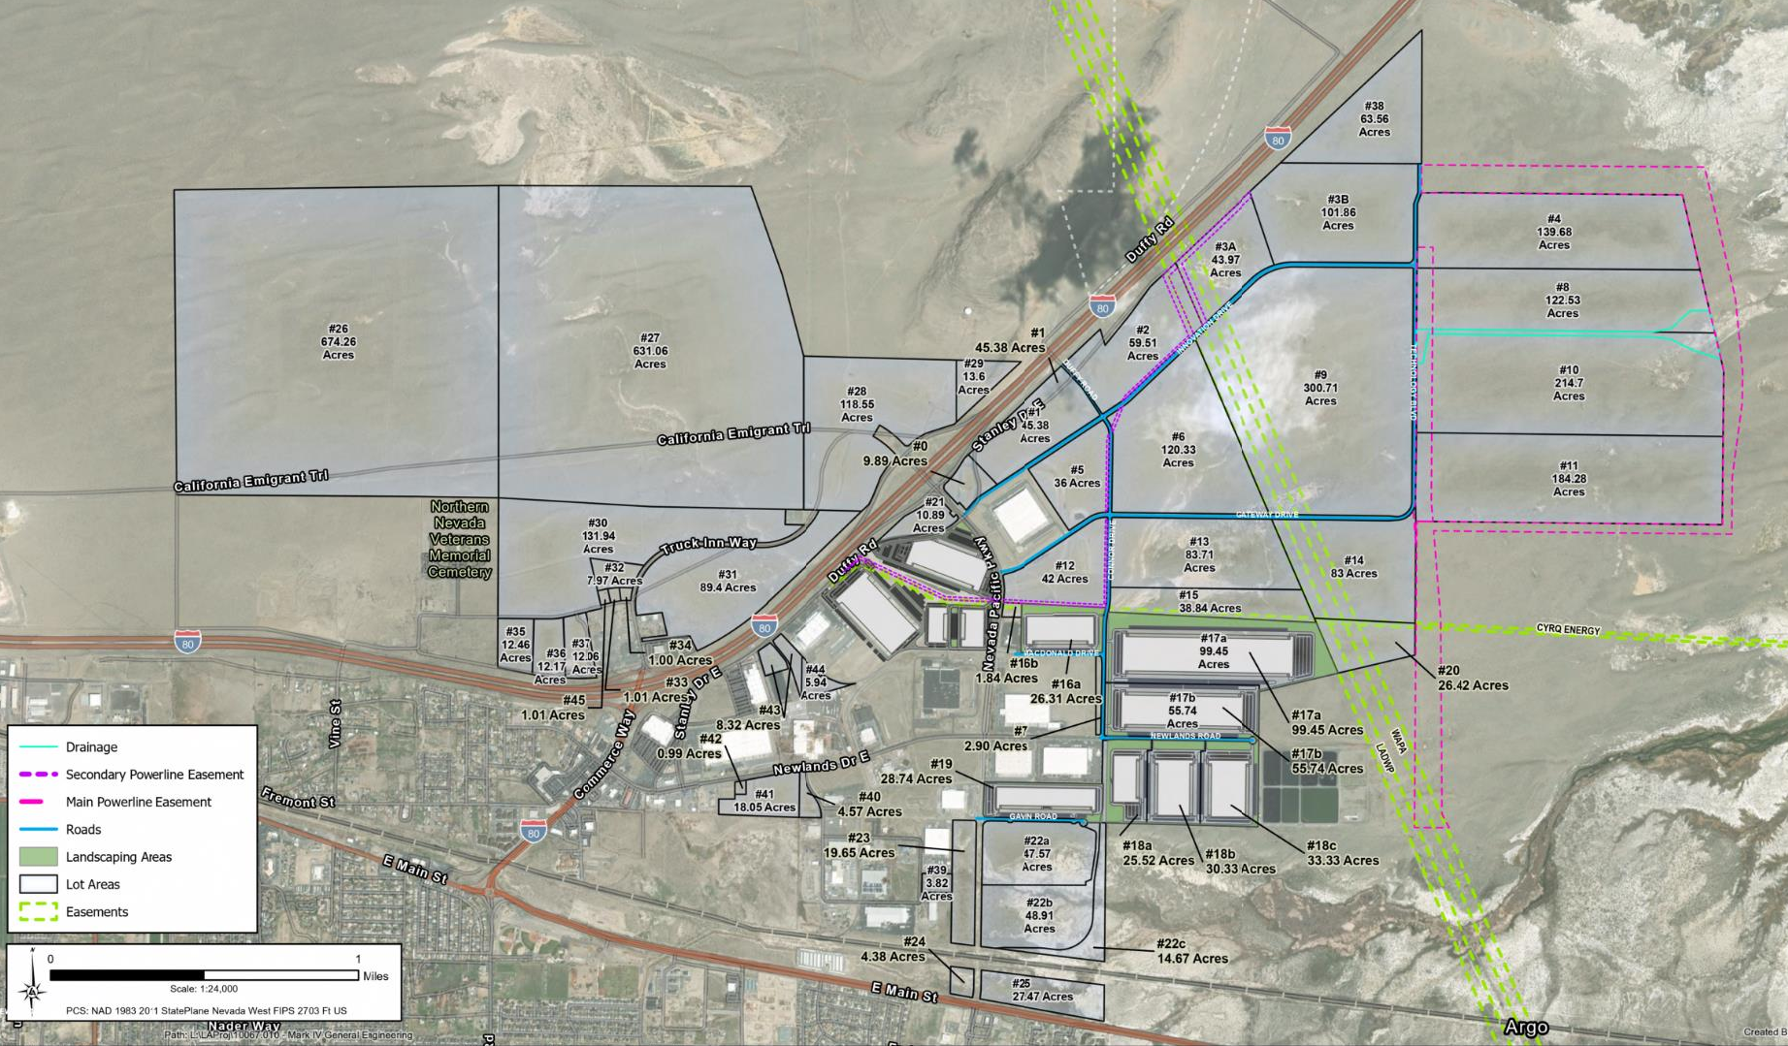
Property History

Slide 4
Nevada Pacific Parkway Grant Award
Mark IV teamed with the City of Fernley to initiate grant applications for CRISI, INFRA and RAISE grants beginning in 2020
Original grant application included additional rail infrastructure within Victory
For grant award within the RAISE program, The City of Fernley and Mark IV were asked to reduce the project
Final project defined within the RAISE Grant award included a $25M grant for the preliminary project total of $52M
Originally, the RAISE grant project was managed by the Federal Rail Administration, but eventually was transferred to the FHWA
NDOT was then brought in to complete the project under it’s LPA program with the City of Fernley and a public/private partnership with Mark IV Capital
Design team includes Lumos & Associates, GCW, TY Lin, UES, and HMMH

Slide 5
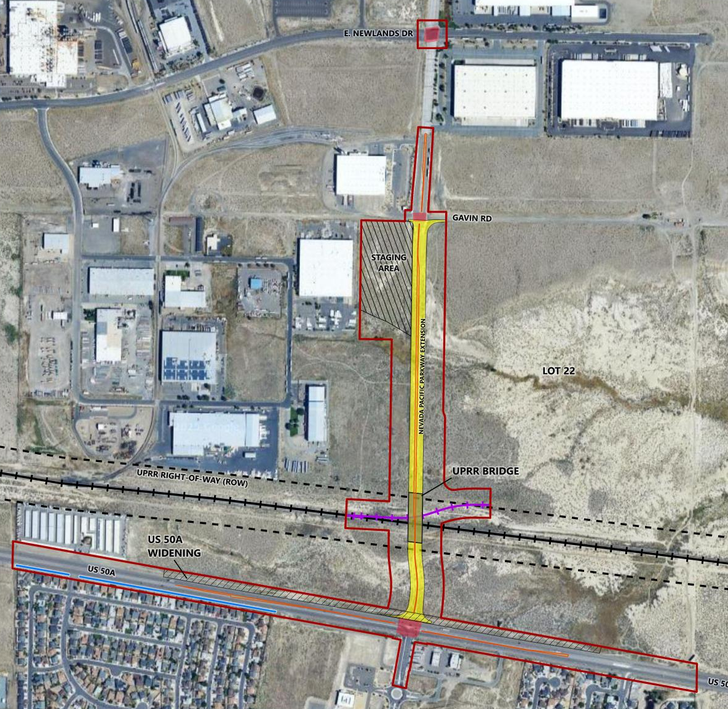
Nevada Pacific Parkway Project
Grant Approved Project:
3,100’ of new 6 lane expressway with 110’ right-of-way
405’ bridge for grade-separated crossing over Union Pacific Railroad Right-of-Way
761’ of industrial lead tying into a new switch along the UPRR main line and terminating on Mark IV property
Intersection signalization at E. Newlands Dr, Gavin Road, and US 50A
Taper improvements along US 50A
Sound wall installation along the south west area of US 50A

Slide 6
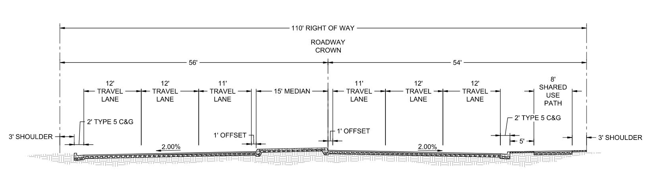
Roadway Improvements
Build out for future growth within Victory, but also accommodate new traffic patterns from I80 to US 50A connection
8’ Multi-Use path along the east side to provide connectivity to new bike/ped facilities within Victory
Build all infrastructure to meet NDOT standards for the future possibility of NDOT ownership
Nevada Pacific Parkway Typical Section

Slide 7
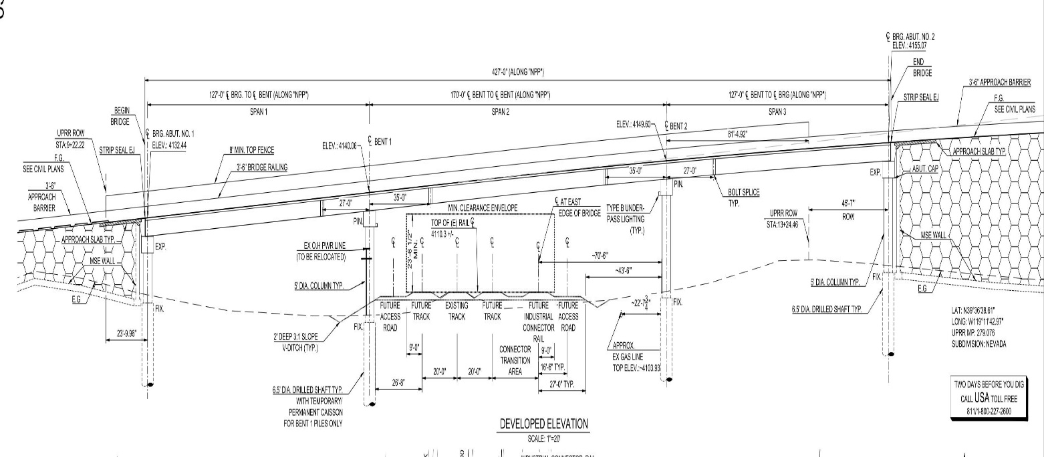
Bridge Improvements
30% concept review submitted to and approved by UPRR
427’ long span optimized to allow for future UPRR track expansion
Utilities will be relocated outside of the bridge structure and will be permitted through UPRR
MSE walls will be installed to maximize land development area adjacent to the roadway
Design exceptions have already been approved to allow for maximum clearance over UPRR

Slide 8
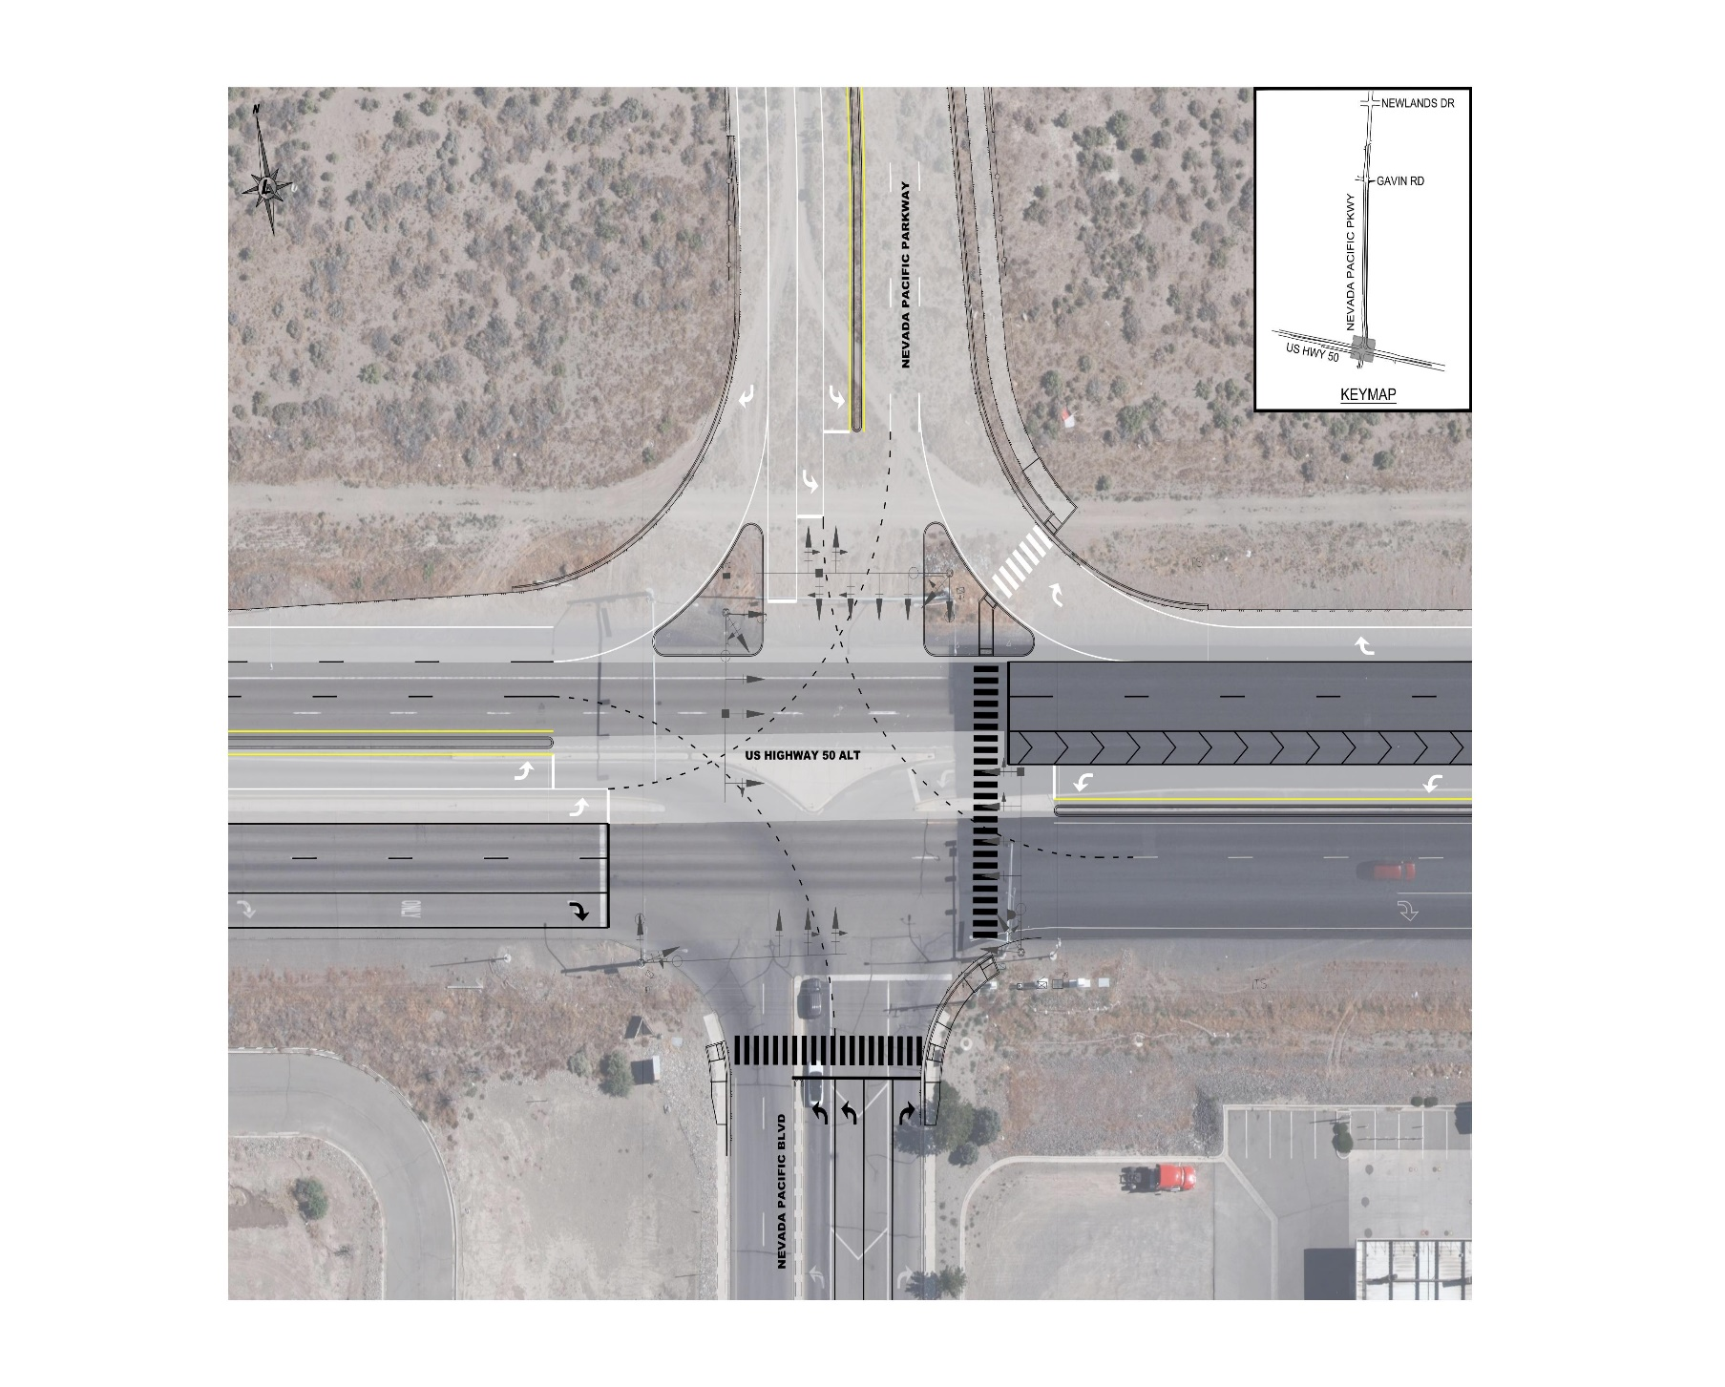
US 50A Improvements
Existing condition is a signalized three-way High-T intersection
Finished condition will be fully signalized four-way intersection
Ped/bike facilities will tie into the southern Nevada Pacific Boulevard walkways
Additional acceleration and deceleration lanes will be added along the north side of the highway
Sound wall will be installed along the south western border of the project

Slide 9
Current Project Status
Current design level is at 30%
UPRR has approved bridge concept design
Geotechnical work is pending and will drive final design
NEPA work to be complete in a month
Potential use of CMAR to complete the project
Federal changes in the grant process could still impact the project

Slide 10
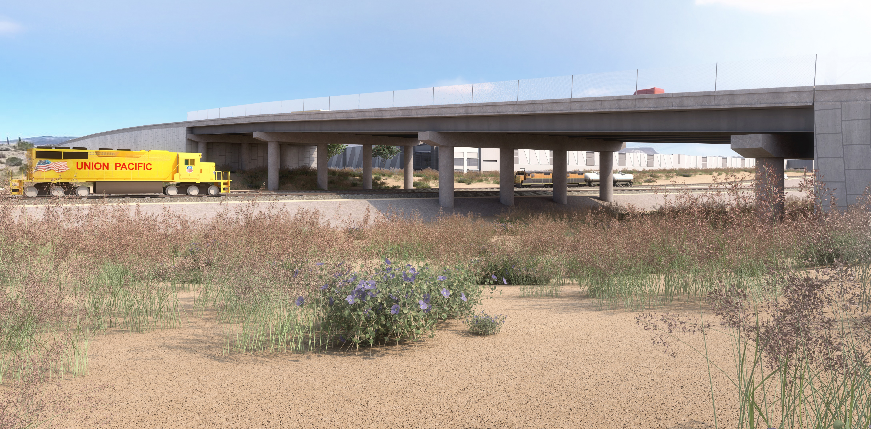
Where are we going?
2025
2026
2027
2028
NEPA Categorical Exclusion completed
60% design complete by year end
100% Design
Grant Obligation must be complete in September
Construction to begin 3rd quarter
Construction Season 1
Rail infrastructure complete
Earthwork complete
Bridge construction commences
Construction Season 2
Finished roadway
Bridge construction complete

Slide 11
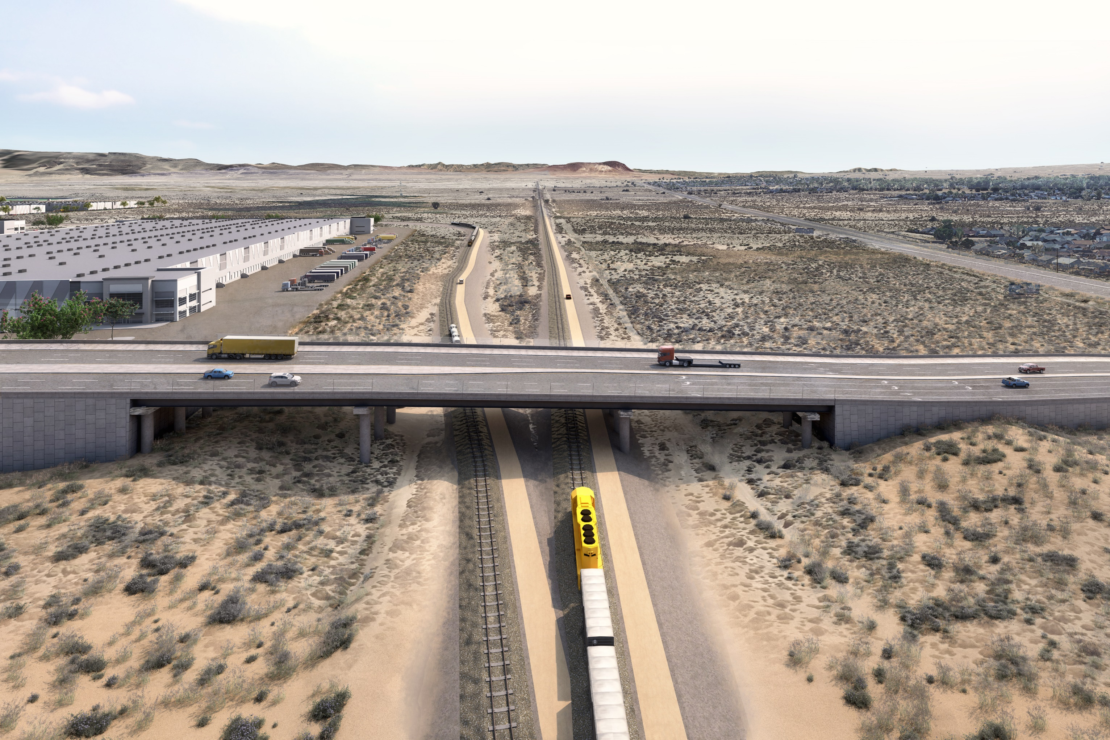
Questions
THANK YOU!
Scott Barnes, P.E.
Mark IV Capital
sbarnes@markiv.com
www.markiv.com
Camille Buehler, P.E., P.L.S.
Lumos & Associates
cbuehler@lumosinc.com
www.lumosinc.com

